Slide 1
Sen-220 software engineering
Process models and agile

Slide 2

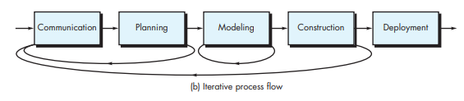
PROCESS FLOW
Linear process flow each of the five activities in flow.
An Iterative process flow repeats one or more of the activities before proceeding to the next.

Slide 3
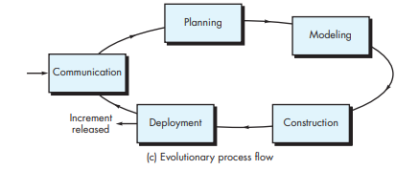
PROCESS FLOW
An evolutionary process flow executes the activities in a circular manner. Each circuit leads to more complete version of the software.

Slide 4
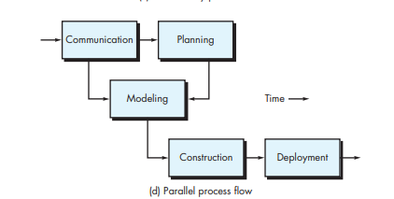
PROCESS FLOW
A parallel process flow executes one or more activities in parallel with other activities.

Slide 5
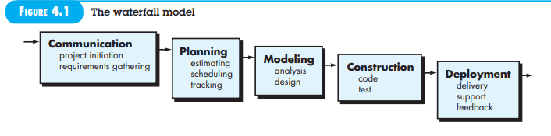
The waterfall model
The waterfall model is a classical model used in software development life cycle (SDLC) to create a system with a linear and sequential approach. It is termed as waterfall because the model develops systematically from one phase to another in a downward fashion.
In a waterfall model, each phase must be completed fully before the next phase can begin. This type of software development model is basically used for the project which is small and there are no uncertain requirements.
As it is static, this methodology is not suitable for projects where client or business requirements may change during development
Once an application is in the testing stage, it is very difficult to go back and change something that was not well-thought out in the concept stage.

Slide 6
THE V-MODEL
V-model means Verification and Validation model. Just like the waterfall model, the V-Shaped life cycle is a
sequential path of execution of processes. Each phase must be completed before the next phase begins.
Testing of the product is planned in parallel with a corresponding phase of development in V-model.

Slide 7
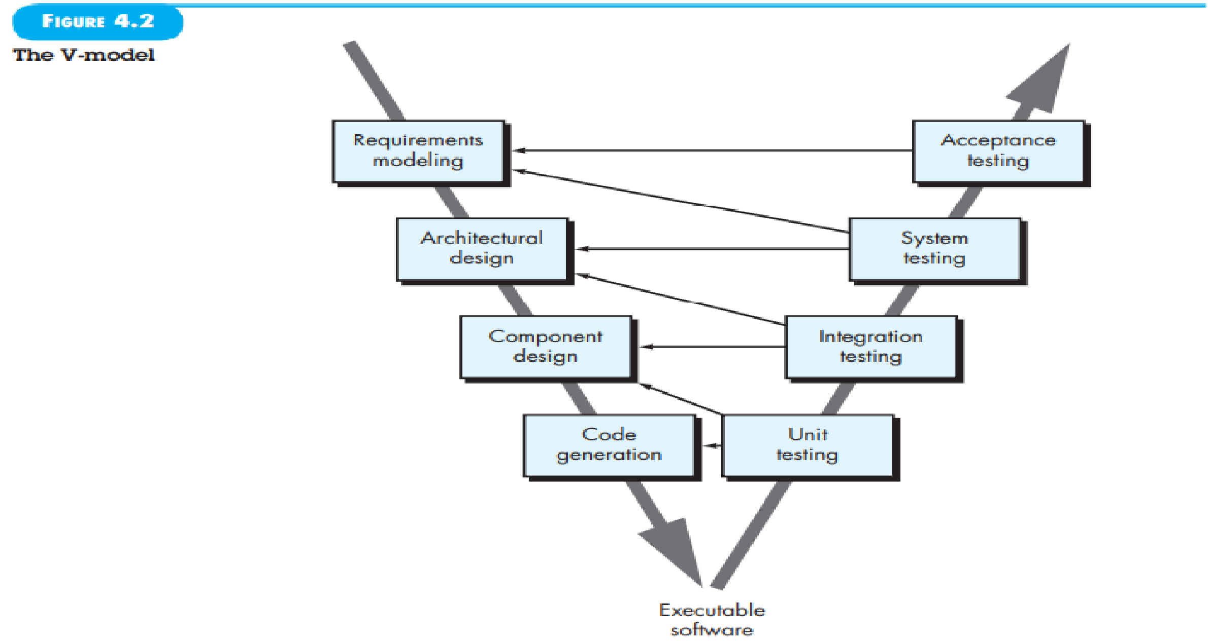

Slide 8
UNIT TESTING
Unit testing involves the testing of each unit or an individual component of the software application. It is the first level of functional testing. The aim behind unit testing is to validate unit components with its performance.
A unit is a single testable part of a software system and tested during the development phase of the application
software.
The purpose of unit testing is to test the correctness of isolated code. A unit component is an individual function or code of the application. White box testing approach used for unit testing and usually done by the developers.
Whenever the application is ready and given to the Test engineer, he/she will start checking every component of the module or module of the application independently or one by one, and this process is known as Unit testing or components testing.

Slide 9
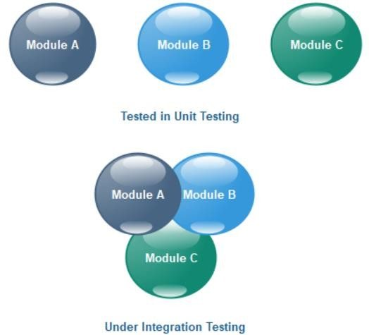
INTEGRATION TESTING
Integration testing is the second level of the software testing process comes after unit testing. In this testing, units or individual components of the software are tested in a group.The focus of the integration testing level is to expose defects at the time of interaction between integrated components or units.
Unit testing uses modules for testing purpose, and these modules are combined and tested in integration testing.The Software is developed with a number of software modules that are coded by different coders or programmers.The goal of integration testing is to check the correctness of communication among all the modules.

Slide 10
SYSTEM TESTING
System testing is testing conducted on a complete integrated system to evaluate the system's compliance with its specified requirements. System testing takes, as its input, all of the integrated components that have passed integration testing.
There are mainly two widely used methods for software testing, one is White box testing which uses internal coding to design test cases and another is black box testing which uses GUI or user perspective to develop test cases.

Slide 11
ACCEPTANCE TESTING
Acceptance testing is a quality assurance (QA) process that determines to what degree an
application meets end users' approval. Depending on the organization, acceptance testing might take
the form of beta testing (pilot-test), application testing, or end-user testing.
field testing

Slide 12
ADVANTAGES OF V-MODEL
Simple and easy to use.
Testing activities like planning, test designing happens well before coding.This saves a lot of time. Hence higher
chance of success over the waterfall model.
Proactive defect tracking – that is defects are found at early stage.
Avoids the downward flow of the defects.
Works well for small projects where requirements are easily understood.

Slide 13
DISADVANTAGES OF V-MODEL
Very rigid and least flexible.
Software is developed during the implementation phase, so no early prototypes of the software are produced.
If any changes happen in midway, then the test documents along with requirement documents has to be updated.

Slide 14
Incremental model
In incremental model the whole requirement is divided into various builds. Multiple development cycles take place here, making the life cycle a “multi-waterfall” cycle. Cycles are divided up into smaller, more easily managed modules.
In this model, each module passes through the requirements, design, implementation and testing phases. A working version of software is produced during the first module, so you have working software early on during the software life cycle.
Each subsequent release of the module adds function to the previous release. The process continues till the complete system is achieved.

Slide 15
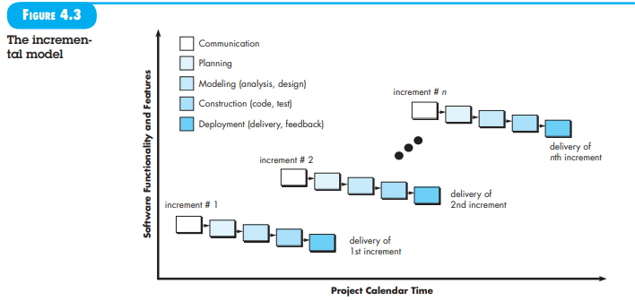

Slide 16
Incremental model example
Example: Ecommerce website Consider a team building an ecommerce website using incremental development. The final target product has search, product information, a shopping basket, checkout, favorites, and customer reviews.
For the first released increment, the team builds the basic functionality to buy a product. It includes search, product information, adding products to a shopping basket and checkout. This first slice would only be released once it’s complete.
The second released increment builds on that basic functionality and would add another capability such as favorites. That would be released when the favorites functionality is complete.
The third released increment adds customer reviews once that is complete, and so on.

Slide 17
Advantages of incremental model
Generates working software quickly and early during the software life cycle.
This model is more flexible – less costly to change scope and requirements.
It is easier to test and debug during a smaller iteration.
In this model customer can respond to each built.
Lowers initial delivery cost.
Easier to manage risk because risky pieces are identified and handled during iteration.

Slide 18
Disadvantages of incremental model
Needs good planning and design.
Needs a clear and complete definition of the whole system before it can be broken down and built incrementally.
Total cost is higher than waterfall.

Slide 19
The spiral model
The spiral model is similar to the incremental model, with more emphasis placed on risk analysis.
The spiral development model is a risk-driven process model.
Example: Microsoft (Early versions of Windows) and NASA's Marshall Space Flight Center (Hendrix and Schneider 2002).

Slide 20
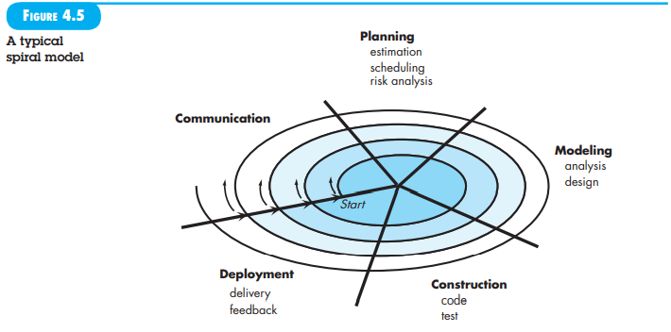
The spiral model

Slide 21
Advantages of the spiral model
High amount of risk analysis hence, avoidance of Risk is enhanced.
Good for large and mission-critical projects.
Additional Functionality can be added at a later date.
Software is produced early in the software life cycle.

Slide 22
Disadvantages of the spiral model
Can be a costly model to use.
Risk analysis requires highly specific expertise.
Project’s success is highly dependent on the risk analysis phase.
Doesn’t work well for smaller projects.

Slide 23
PROTOTYPE MODEL
Prototype is a working model of software with some limited functionality. The prototype does not always hold the exact logic used in the actual software application and is an extra effort to be considered under effort estimation.
Prototyping is used to allow the users evaluate developer proposals and try them out before implementation. It also helps understand the requirements which are user specific and may not have been considered by the developer during product design.

Slide 24
Software Prototyping - Types
Throwaway/Rapid Prototyping
Throwaway prototyping is also called as rapid or close ended prototyping. This type of prototyping uses very little efforts with minimum requirement analysis to build a prototype. Once the actual requirements are understood, the prototype is discarded and the actual system is developed with a much clear understanding of user requirements.
Evolutionary Prototyping
Evolutionary prototyping also called as breadboard prototyping is based on building actual functional prototypes with minimal functionality in the beginning. The prototype developed forms the heart of the future prototypes on top of which the entire system is built. By using evolutionary prototyping, the well-understood requirements are included in the prototype and the requirements are added as and when they are understood.

Slide 25
Software Prototyping - Types
Incremental Prototyping
Incremental prototyping refers to building multiple functional prototypes of the various sub-systems and then integrating all the available prototypes to form a complete system.
Extreme Prototyping
Extreme prototyping is used in the web development domain. It consists of three sequential phases. First, a basic prototype with all the existing pages is presented in the HTML format. Then the data processing is simulated using a prototype services layer. Finally, the services are implemented and integrated to the final prototype. This process is called Extreme Prototyping used to draw attention to the second phase of the process, where a fully functional UI is developed with very little regard to the actual services.

